Slide 1
Practical SPARQL Benchmarking
Rob Vesse
rvesse@yarcdata.com
@RobVesse

Slide 2
Why Benchmark?
Regardless of what technology your solution will be built on (RDBMS, RDF + SPARQL, NoSQL etc) you need to know it performs sufficiently to meet your goals
You need to justify option X over option Y
Business – Price vs Performance
Technical – Does it perform sufficiently?
No guarantee that a standard benchmark accurately models your usage

Slide 3
The Standard Benchmarks
Berlin SPARQL Benchmark (BSBM)
Relational style data model
Access pattern simulates replacing a traditional RDBMS with a Triple Store
Lehigh University Benchmark (LUBM)
More typical RDF data model
Stores require reasoning to answer the queries correctly
SPARQL²Bench (SP2B)
Again typical RDF data model
Queries designed to be hard – cross products, filters, etc.
Generates artificially massive unrealistic results
Tests clever optimization and join performance

Slide 4
Problems with Benchmarking
Often no standardized methodology
E.g. only BSBM provides a test harness
Lack of transparency as a result
If I say I’m 10x faster than you is that really true or did I measure differently?
What actually got measured?
Time to start responding
Time to count all results
Something else?
Even if you run a benchmark does it actually tell you anything useful?

Slide 5
Query Benchmarker - Overview
Java command line tool (and API) for benchmarking
Designed to be highly configurable
Runs any set of SPARQL queries you can devise against any HTTP based SPARQL endpoint
Run single and multi-threaded benchmarks
Generates a variety of statistics
Methodology
Runs some quick sanity tests to check the provided endpoint is up and working
Optionally runs W warm up runs prior to actual benchmarking
Runs a Query Mix N times
Randomizes query order for each run
Discards outliers (best and worst runs)
Calculates averages, variances and standard deviations over the runs
Generates reports as CSV and XML

Slide 6
Query Benchmarker – Key Statistics
Response Time
Time from when query is issued to when results start being received
Runtime
Time from when query is issued to all results being received and counted
Exact definition may vary according to configuration
Queries per Second
How many times a given query can be executed per second
Query Mixed per Hour
How many times a query mix can be executed per hour

Slide 7
Demo

Slide 8
Example Results - Configuration
SP2B at 10k, 50k and 250k run with 5 warm-ups and 25 runs
All options left as defaults i.e. full result counting
Runs for 50k and 250k skipped if store was incapable of performing the run in reasonable time
Run on following systems
*nix based stores run on late 2011 Mac Book Pro (quad core, 8GB RAM, SSD)
Java heap space set to 4GB
Windows based stores run on HP Laptop (dual core, 4GB RAM, HDD)
Both low powered systems compared to servers
Benchmarked Stores
Jena TDB 0.9.1
Sesame 2.6.5 (Memory and Native Store)
Bigdata 1.2 (WORM Store)
Dydra
Virtuoso 6.1.3 (Open Source Edition)
dotNetRDF (In-Memory Store)
NB – Final slides may cover more stores subject to time and vendor agreements

Slide 9
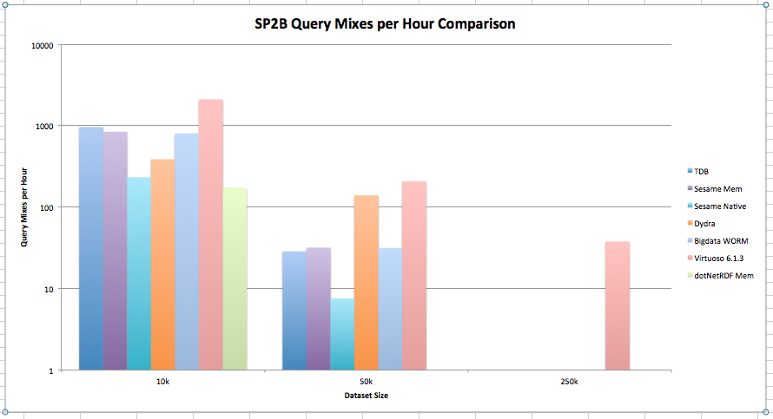
Example Results – QMpH

Slide 10
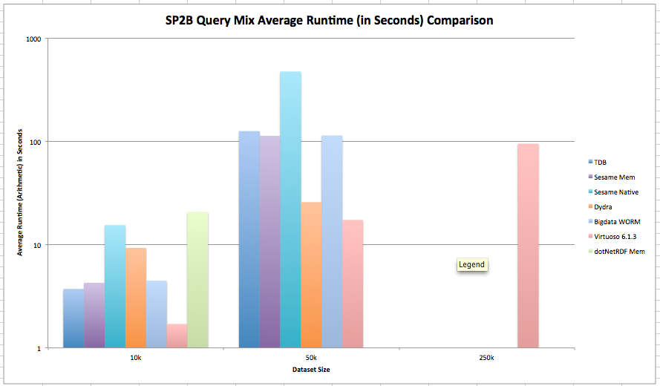
Example Results – Average Mix Runtime

Slide 11
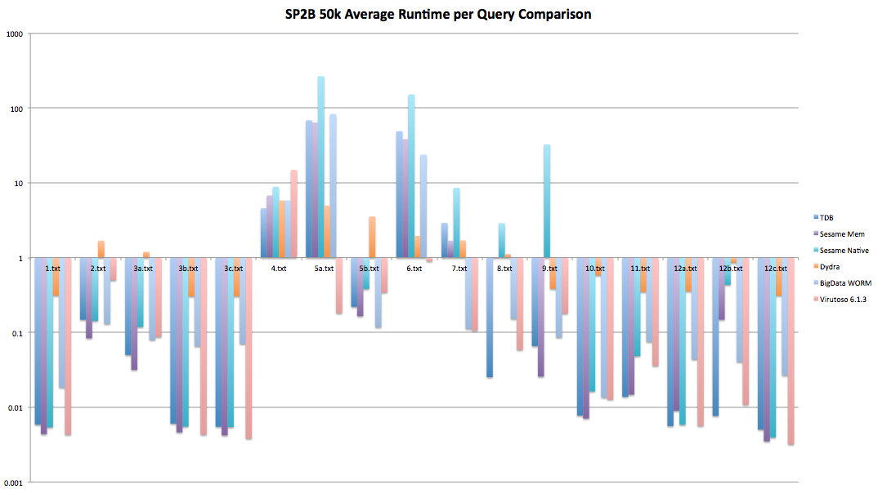
Example Results – Query Runtimes

Slide 12
Code & Example Results
Code Release is Management Approved
Currently undergoing Legal and IP Clearance
Should be open sourced shortly
Apologies this isn’t yet available at time of writing
Example Results data available from:
TBC – Will be available on day of presentation

Slide 13
Questions?

